Slide 1
Model Quality
Cloud AI

Slide 2
How good is the model?
The model should generalize to unseen data
If you are using it to predict
if it’s just to explain the data overfitting isn’t a problem
Split up the given dataset:
Build model on training dataset (e.g. 70%)
Test model using test set (remaining 30%)
Calculate RMSE on both datasets
Check that the RMSE on training is as low as it can be, but that the RMSE of test isn’t significantly higher
Notes:
RMSE: see later

Slide 3
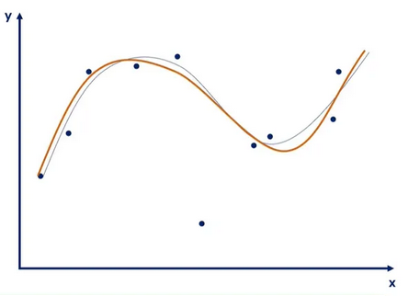
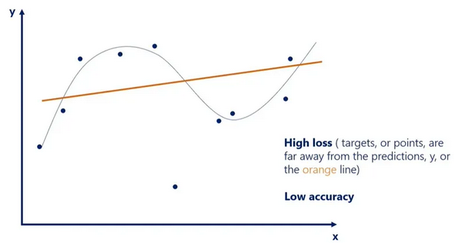
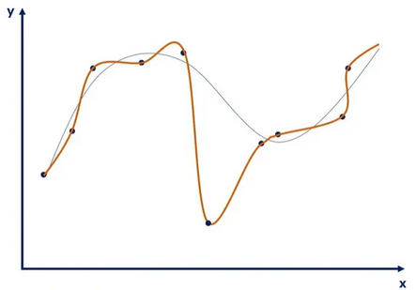
Overfitting and underfitting
Good model
Line follows datapoints correctly
Obvious outliers are ignored
Underfitting
Line only vaguely follows datapoints
Outliers are ignored, but some data points too
Is equally bad with unseen data as with trained data
Can be a bad model, but also not enough training
Overfitting
Line follows datapoints exactly
Outliers are taken very much into account
Does not generalize to unseen data
Model too complex, or too much training
Notes:
https://365datascience.com/tutorials/machine-learning-tutorials/overfitting-underfitting/
A lot more about this topic will follow in session 3.

Slide 4
Overfitting and underfitting
Overfitting and underfitting are measured using the RMSE
In the example in the previous slide we’re not using a linear regression but a polynomial regression
The question we are asking is how many polynomials we should be using
A 17th-order function will have 17 zero-crosses, so will follow the data very well, but have next to no explainability

Slide 5
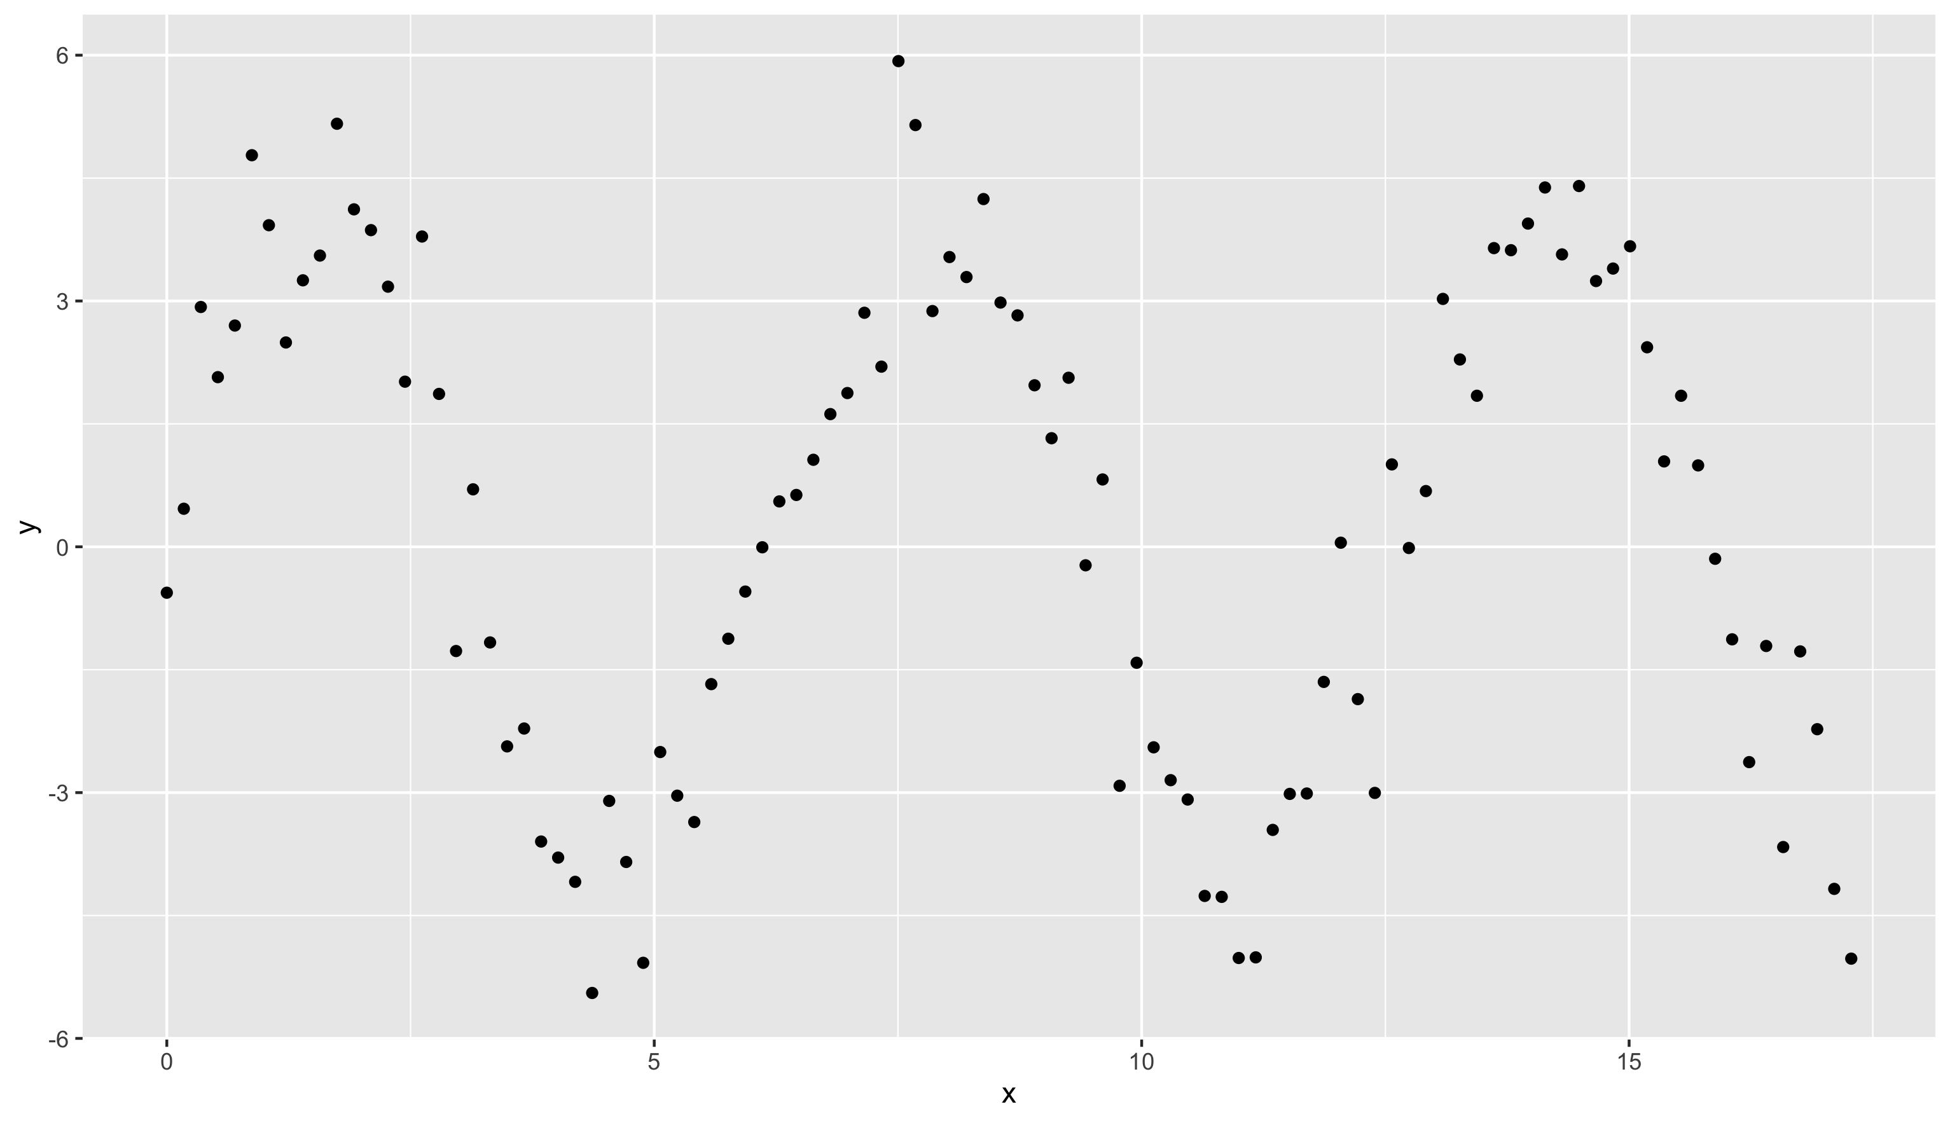
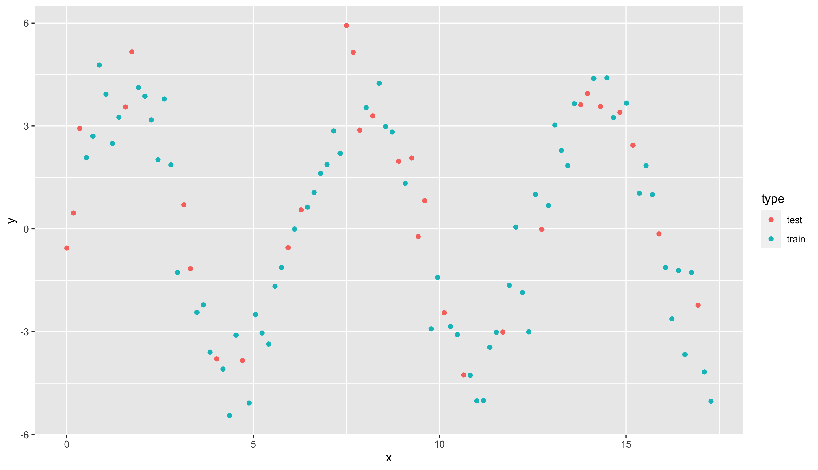
Modeling more complex patterns
A classical linear model will not do!

Slide 6
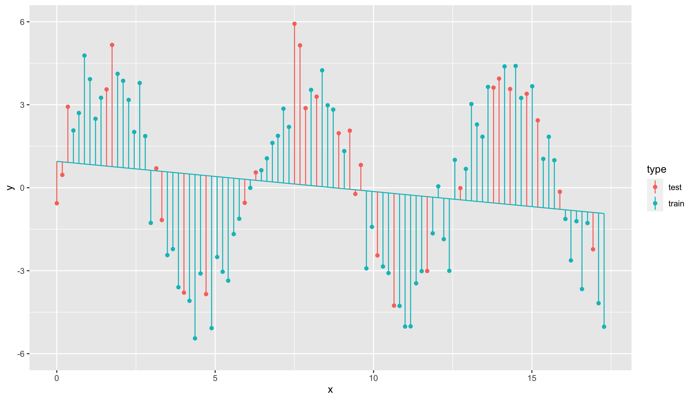
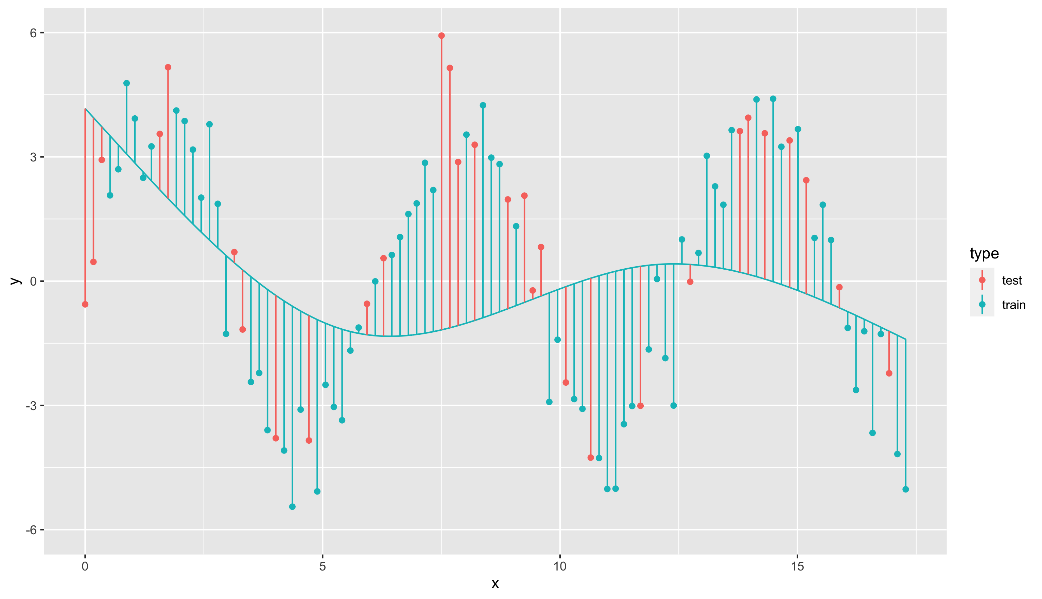
Modeling more complex patterns
Natural spline with 1 degrees of freedom
Natural spline with 3 degrees of freedom
RMSE_train = 2.971
RMSE_test = 3.020
RMSE_train = 2.779
RMSE_test = 3.204

Slide 7
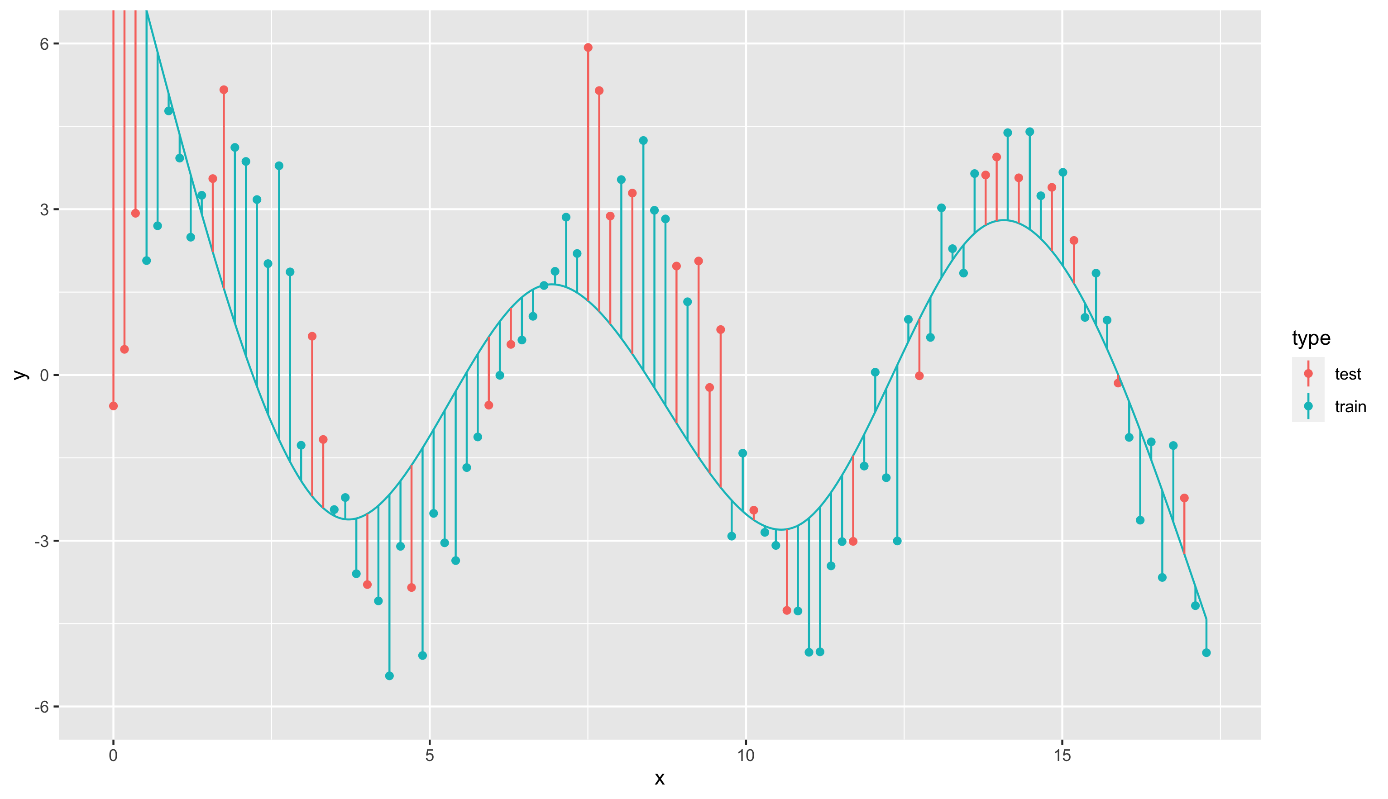
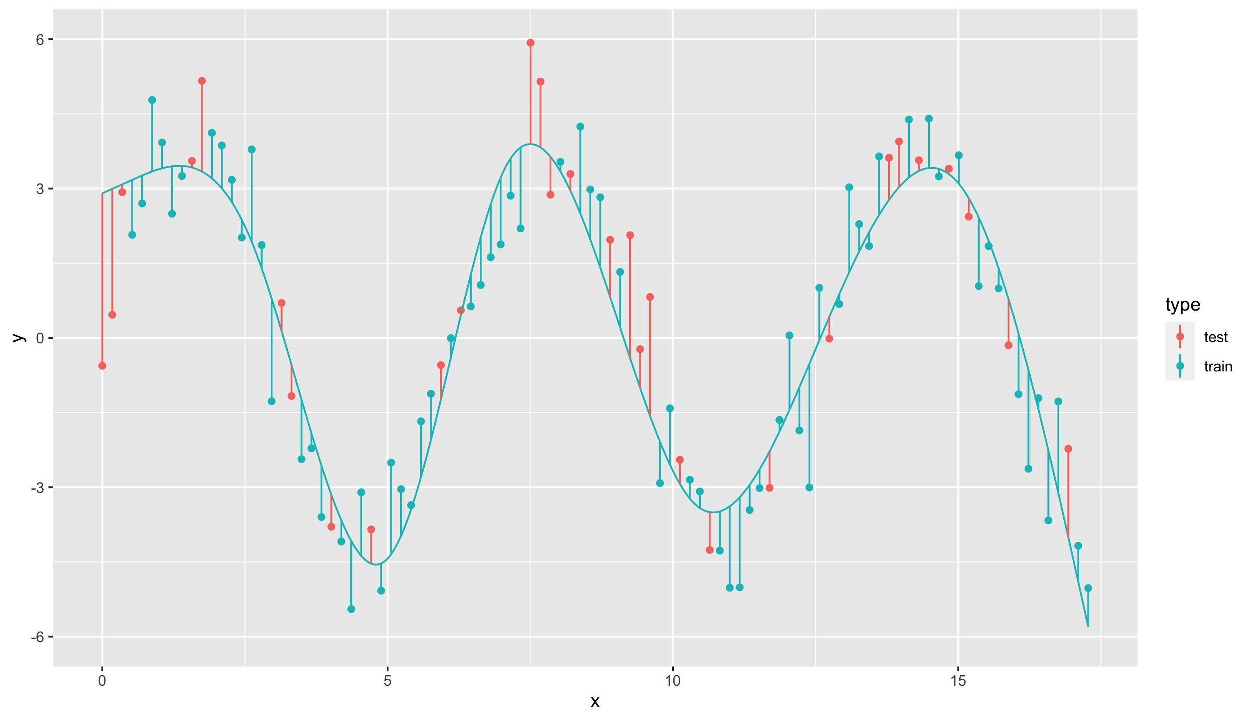
Modeling more complex patterns
Natural spline with 5 degrees of freedom
Natural spline with 7 degrees of freedom
RMSE_train = 1.988
RMSE_test = 3.120
RMSE_train = 1.092
RMSE_test = 1.310

Slide 8
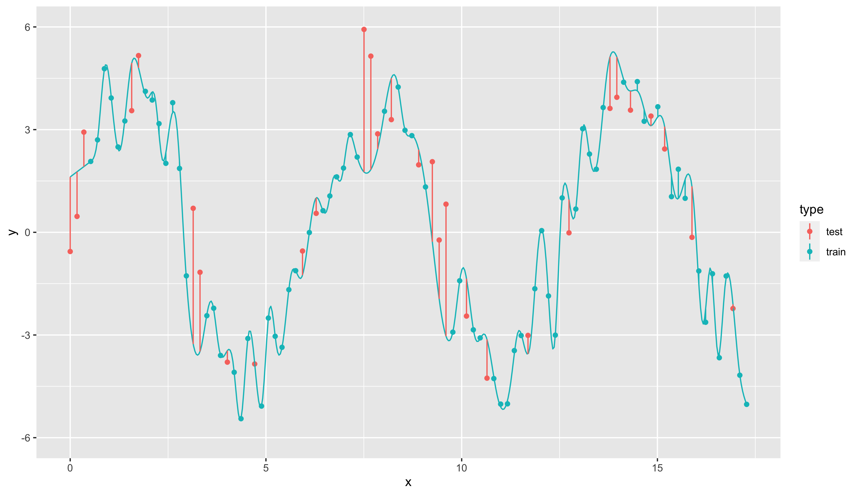
Modeling more complex patterns
Natural spline with 65 degrees of freedom
RMSE_train = 0.189
RMSE_test = 1.783
Error on training is low, but error on test set is much higher Model does not generalize well.

Slide 9
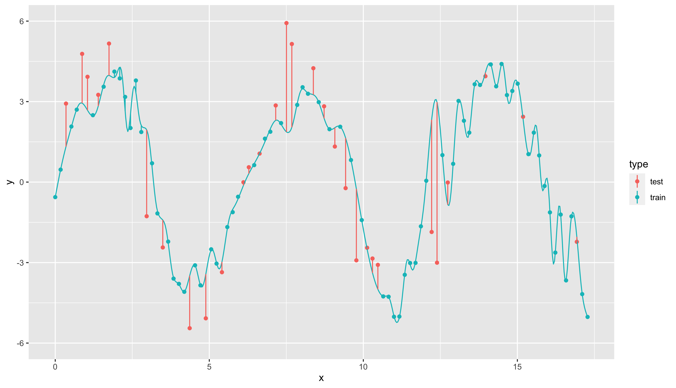
Sensitivity to train/test split
Natural spline with 65 degrees of freedom,
train/test split v1
Natural spline with 65 degrees of freedom train/test split v2
Also called variance: error from sensitivity to small fluctuations in the training set

Slide 10
Under- and overfitting
Natural spline with 3 degrees of freedom
Natural spline with 65 degrees of freedom
Underfitting
Model is not complex enough
Overfitting
Model is too complex
Model is too sensitive to the training data Model does not generalize well

Slide 11
The bias-variance tradeoff
High bias
Low variance
Low bias
High variance
Notes:
High bias: model is bad for the data
Low variance: Another train/test-split would have given roughly the same model
Low bias: Model is really well fitted to the data
High variance: Another train/test-split would have given a very different model

Slide 12
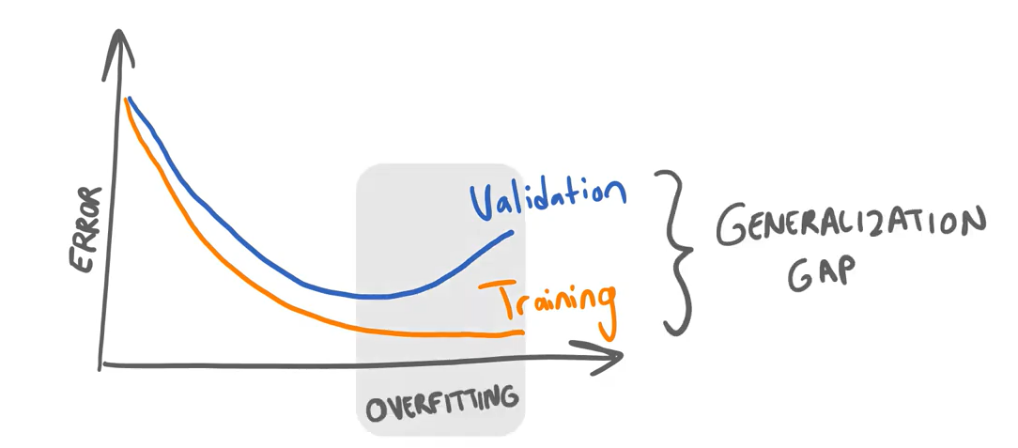
How to find the sweet spot?
Not allowed to use the test set!
Split up dataset in 3 parts
Build model on training set (60%)
Check complexity against validation set (20%)
Verify quality on test set (20%)

Slide 13
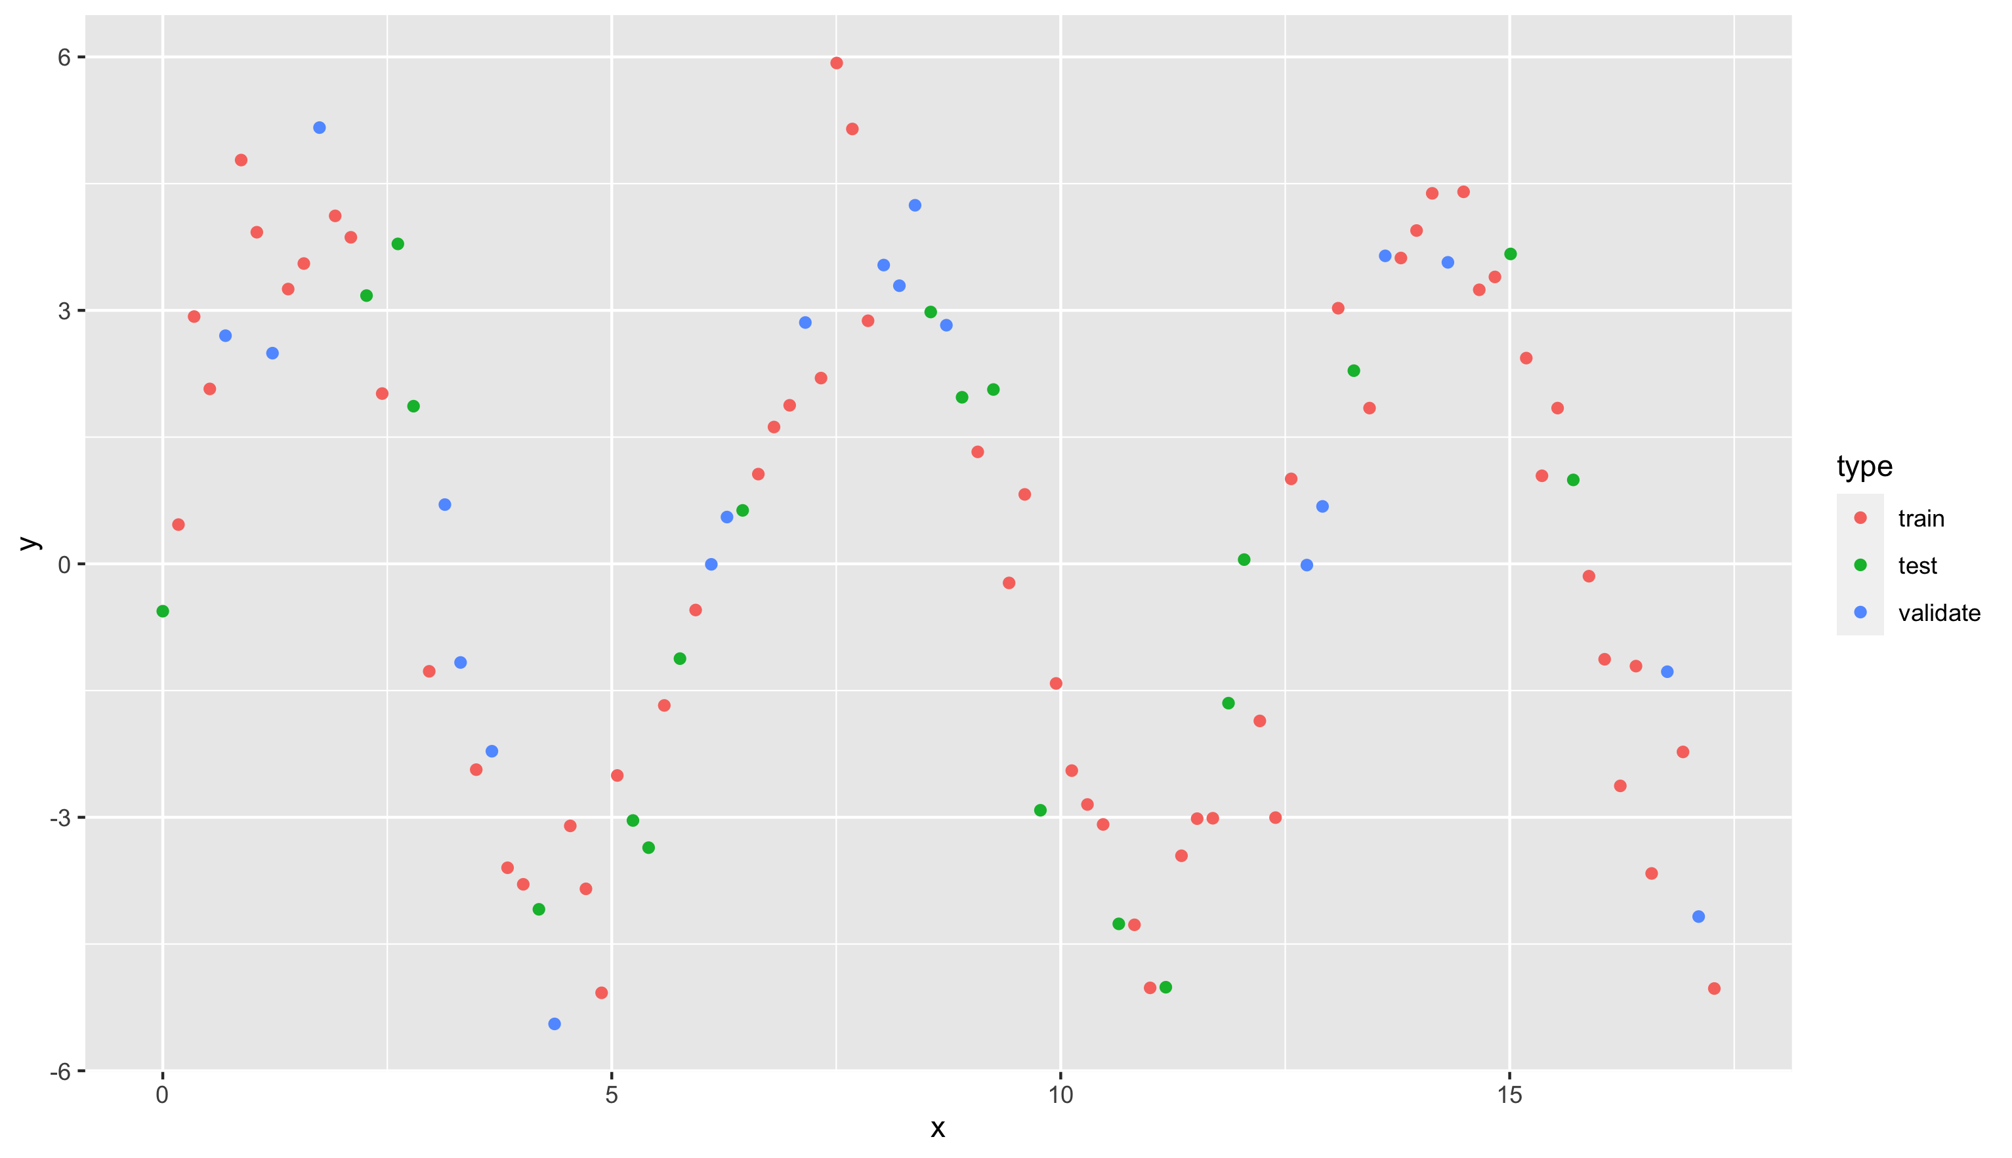
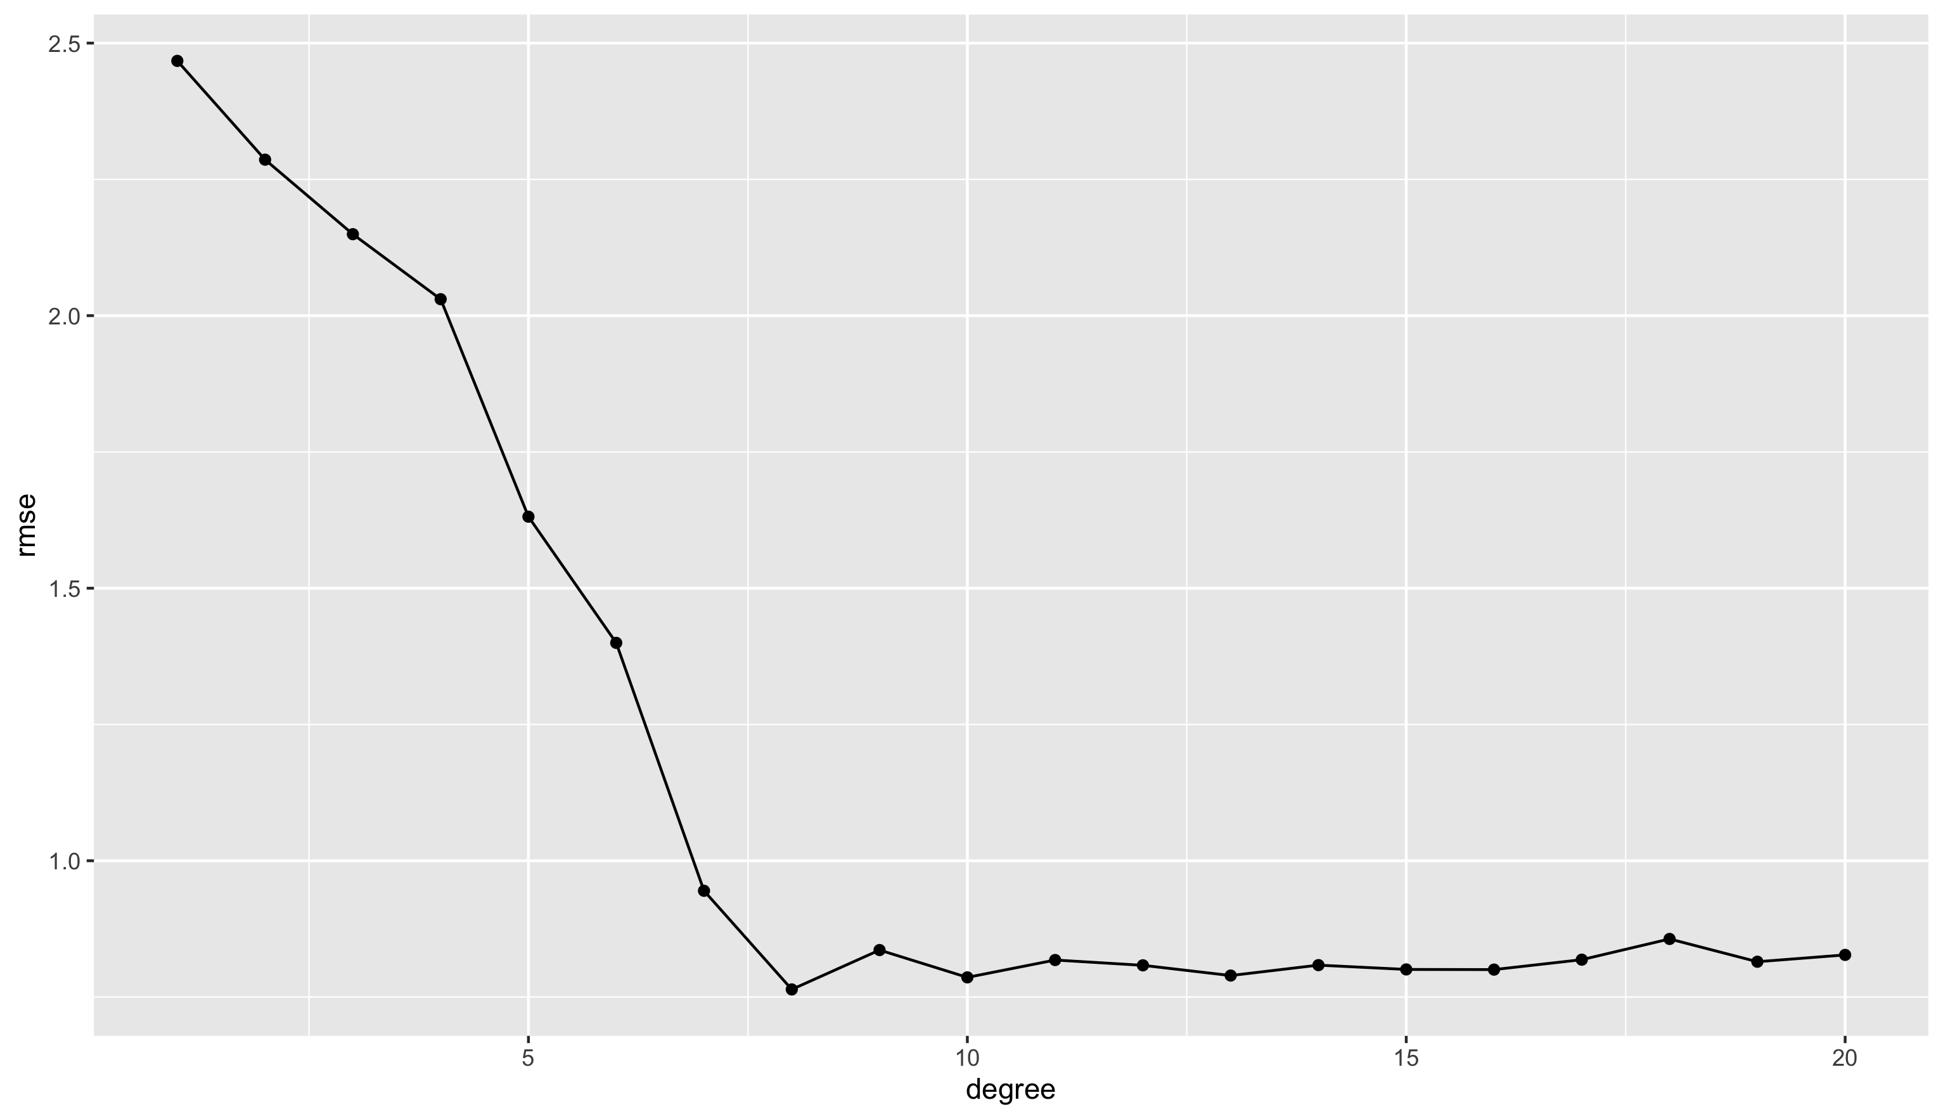
Divide data in three subsets Track RMSE as complexity increases
Low bias High variance
Sweet spot OK bias OK variance
High bias Low variance
No improvement

Slide 14

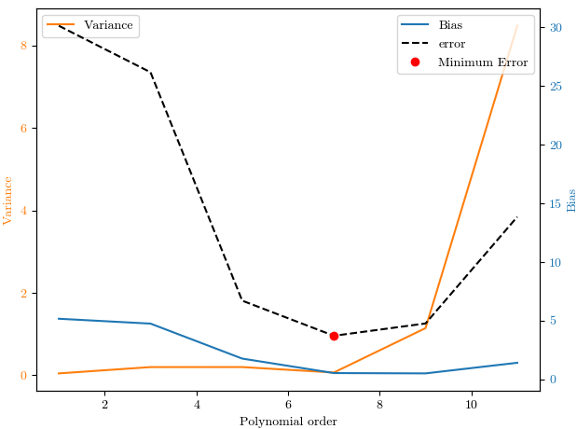
3.1 - bias variance tradeoff
For clean and large enough dataset:
The greater the model complexity the lower the estimation error, the better the approximation.
The greater the model complexity the lower the bias
The greater the model complexity the lower the variance
For noisy dataset:
Greater model complexity doesn’t mean lower estimation error
The greater the model complexity the lower the bias
The greater the model complexity the higher the variance
Notes:
https://towardsdatascience.com/understanding-the-bias-variance-tradeoff-and-visualizing-it-with-example-and-python-code-7af2681a10a7

Slide 15
Problems in data
The data you get will have issues
Not made available
Wrong format
Datetimes (not a real problem, but annoying)
Contains outliers
Ordinal and nominal (important to figure out)
Contains missing values
Has bias
Notes:
Not made available: a student last year’s internship was “scrape all the price data for holiday parks, so our client can use this data to better position themselves in the market.” Very nice dataset by the way.
Wrong format: Feature engineering
Datetimes: https://datagy.io/pandas-datetime/

Slide 16
3.2 - Errors in data.md
There can be many errors or annoyances in data
They’re explained in in the markdown-file in on github
The full story
But also on the following slides…
The abbreviated version

Slide 17
Outliers
Definition: Outliers are data points that significantly deviate from the rest of the dataset.
Identification: Techniques include visual inspection (scatter plots, box plots), statistical methods (z-score), and machine learning algorithms (isolation forests).
Impact: Outliers can distort statistical analyses and affect summary statistics and regression models.
Handling: Strategies include removing outliers, data transformation, winsorization, robust statistics, and creating separate models.

Slide 18
Categorical Data
Definition: Categorical data represents distinct groups or categories, divided into nominal and ordinal data.
Nominal Data: Categories without inherent order (e.g., gender, hair color).
Ordinal Data: Categories with a specific order (e.g., satisfaction ratings).
One-Hot Encoding: Technique to represent categorical variables as binary vectors for machine learning.

Slide 19
Missing Values
Identification: Use DataFrame.info() in pandas to find missing values.
Handling: Strategies include removing rows/columns, imputation (mean, median, regression, KNN), special value imputation, and creating indicator variables.

Slide 20
Bias
Types of Bias:
Sampling Bias: Non-representative sample.
Selection Bias: Influenced selection of data points.
Measurement Bias: Errors in measurement.
Reporting Bias: Systematic difference in reporting.
Confirmation Bias: Selective search for confirming information.
Algorithmic Bias: Discrimination in machine learning models.
Survivor Bias: Focus on surviving data points.
Snoop Bias: Test data influencing training process.
Mitigation: Random sampling, rigorous study designs, careful measurement, transparency, and regular bias assessments.

Slide 21


Scaling
Scaling: adjust range of data to fit between 0 and 1 (or something similar)
Min-max scaling:
Standarization:
Will provide you with data that is easier for algorithms to compare
Length in meters (between 1.5 and 2) and shoe size (35-45)

Slide 22
More exercises!
3.1, bike-highways (on grouping data)

